Slide 1



















Tahaluf Copyright 2022- All Right Reserved
Harmony IT Solution
learning Hub
Web Application Programming Interface (API)
Tahaluf Training Center 2022

Slide 2



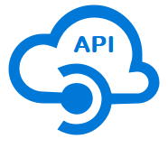





Tahaluf Copyright 2022- All Right Reserved
Harmony IT Solution
1
Postman
2
Create API Project
3
Overview of Project Architecture
4
4
Class Library
5
4
7
6
8
8
9

Slide 3










Tahaluf Copyright 2022- All Right Reserved
Harmony IT Solution
Postman

Slide 4

Tahaluf Copyright 2022- All Right Reserved
Harmony IT Solution
Postman is an Application Programming Interface (API) development tool used to build, test and modify APIs.
Postman has the ability to make different types of HTTP methods (GET, PUT, PATCH, POST), converting the API to code for various languages(like Python, JavaScript), saving environments for later use.

Slide 5
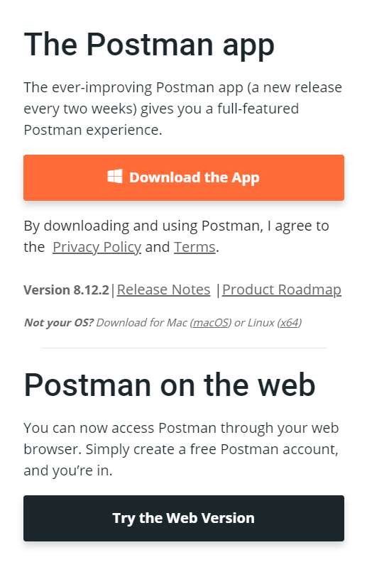
Tahaluf Copyright 2022- All Right Reserved
Harmony IT Solution
Open the following link: https://www.postman.com/downloads/

Slide 6
Tahaluf Copyright 2022- All Right Reserved
Harmony IT Solution
Create API Project

Slide 7
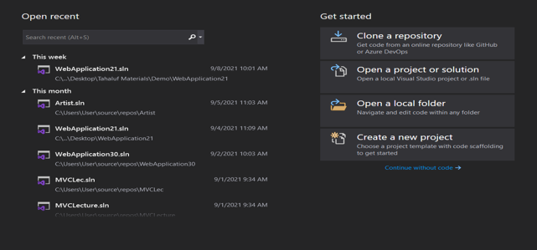
Tahaluf Copyright 2022- All Right Reserved
Harmony IT Solution
Open Visual Studio

Slide 8
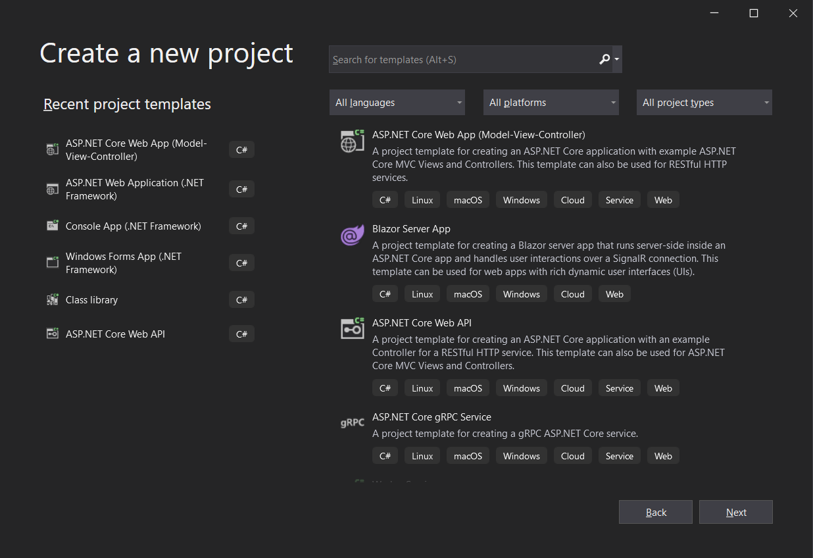
Tahaluf Copyright 2022- All Right Reserved
Harmony IT Solution
Choose ASP.NET Core Web API.

Slide 9
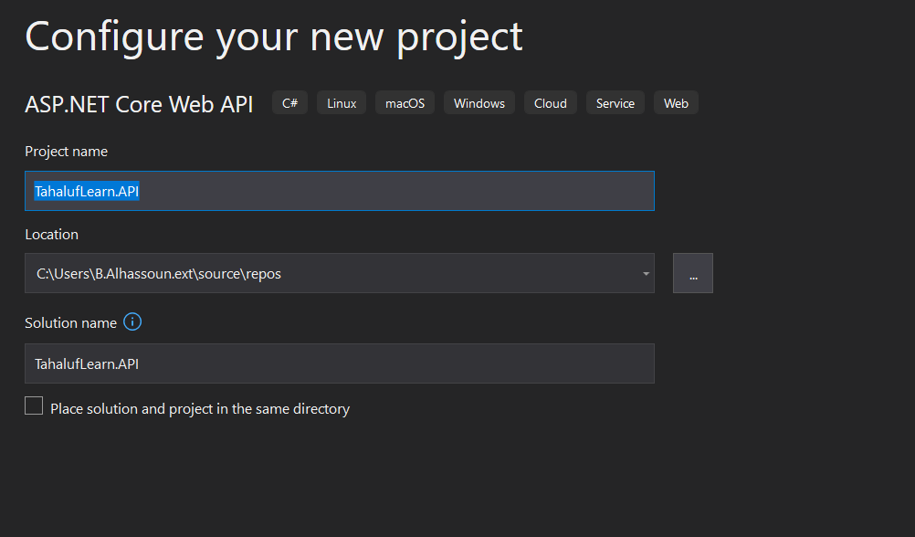
Tahaluf Copyright 2022- All Right Reserved
Harmony IT Solution
Enter Project name and Solution name.

Slide 10
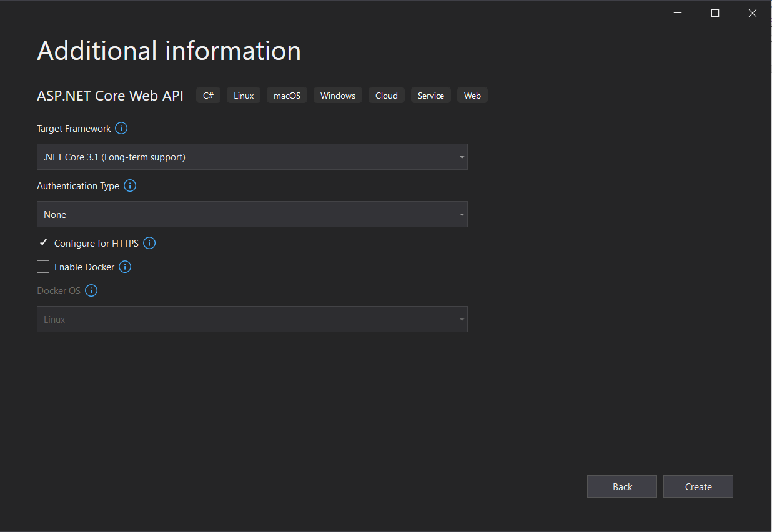
Tahaluf Copyright 2022- All Right Reserved
Harmony IT Solution
Choose Target Framework.

Slide 11
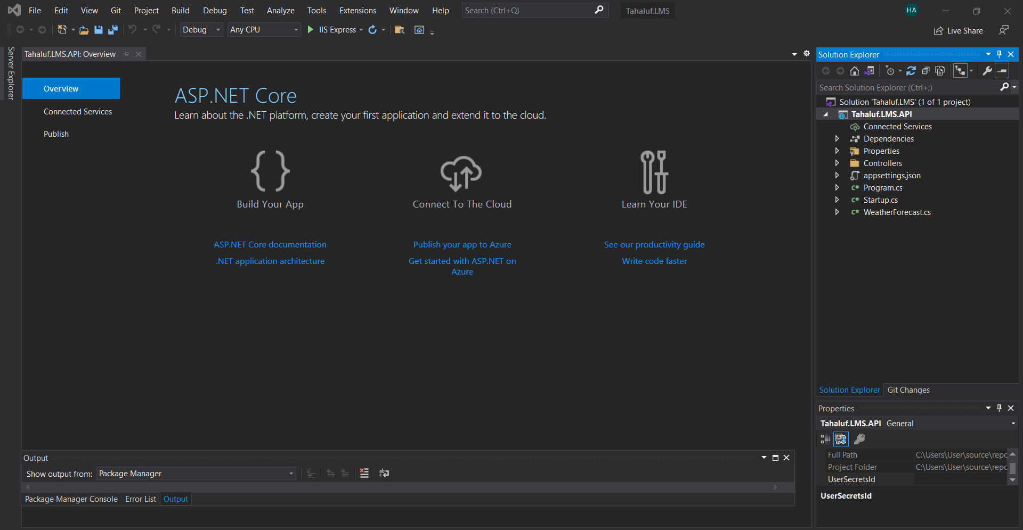
Tahaluf Copyright 2022- All Right Reserved
Harmony IT Solution
The Project is created

Slide 12
Tahaluf Copyright 2022- All Right Reserved
Harmony IT Solution
Overview of Project Architecture

Slide 13
Tahaluf Copyright 2022- All Right Reserved
Harmony IT Solution
What is Program.cs?
Program.cs is a place where the application starts.
Program.cs file work like Program.cs file that used in traditional .NET Framework console application.
Program.cs fille represent the entry point of project and it is used to register IISIntegration, Startup.cs fill and Create a host in the Main method.

Slide 14
Tahaluf Copyright 2022- All Right Reserved
Harmony IT Solution
What is Startup.cs?
Startup class provides the entry point for an project, and is required for all applications.
The Startup class can accept dependencies in its constructor that are provided by dependency injection.

Slide 15
Tahaluf Copyright 2022- All Right Reserved
Harmony IT Solution
What is appsetting.json?
The appsettings.json file is a configuration file used to store configuration settings like any application scope global variables , database connections strings, etc.

Slide 16
Tahaluf Copyright 2022- All Right Reserved
Harmony IT Solution
What is Controller?
Web API Controller is similar to ASP.NET Core MVC controller. It handles incoming HTTP requests from the server and send response to the caller.

Slide 17
Tahaluf Copyright 2022- All Right Reserved
Harmony IT Solution
Class Library

Slide 18
Tahaluf Copyright 2022- All Right Reserved
Harmony IT Solution
Class libraries are the shared library concept for .NET.
They enable to componentize useful functionality into modules that can be used by multiple applications.
They used as a means of loading functionality that is not known or not needed at application startup.
Class libraries are described by the .NET Assembly file format.

Slide 19
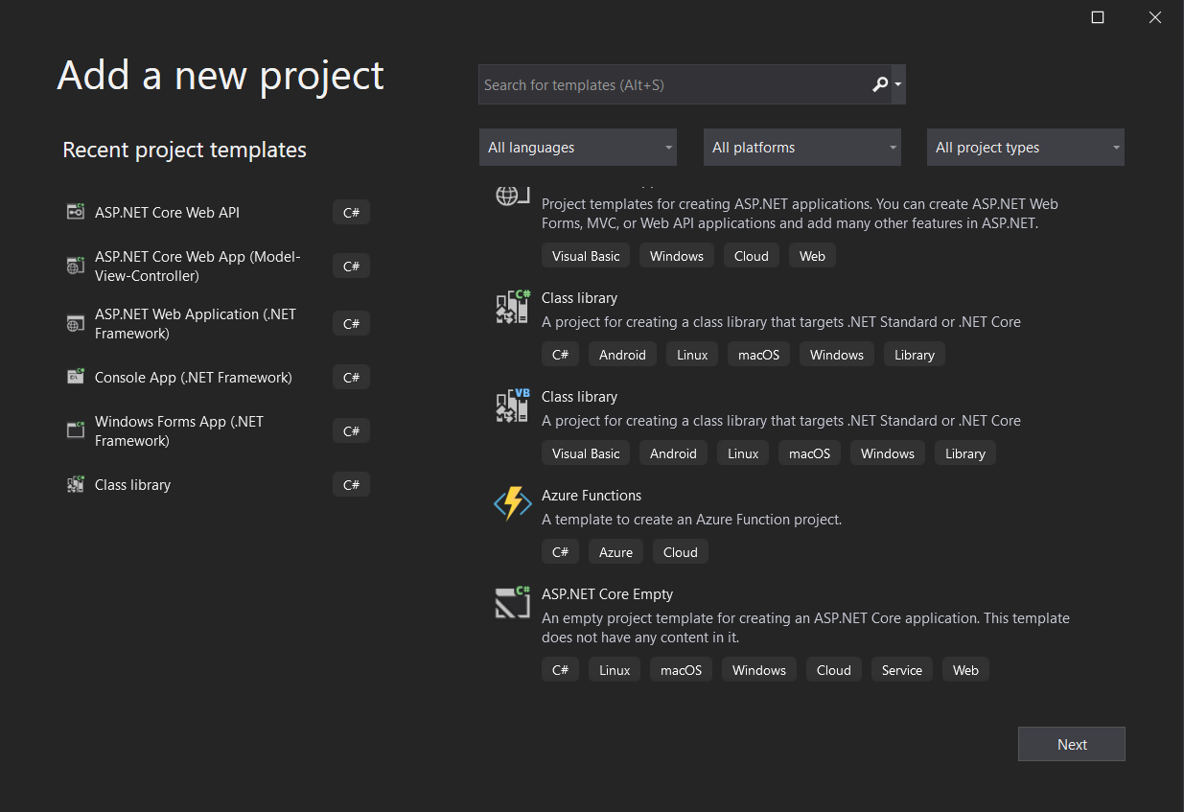
Tahaluf Copyright 2022- All Right Reserved
Harmony IT Solution
Right Click on Solution Name => Add => New Project => Choose Class Library.

Slide 20
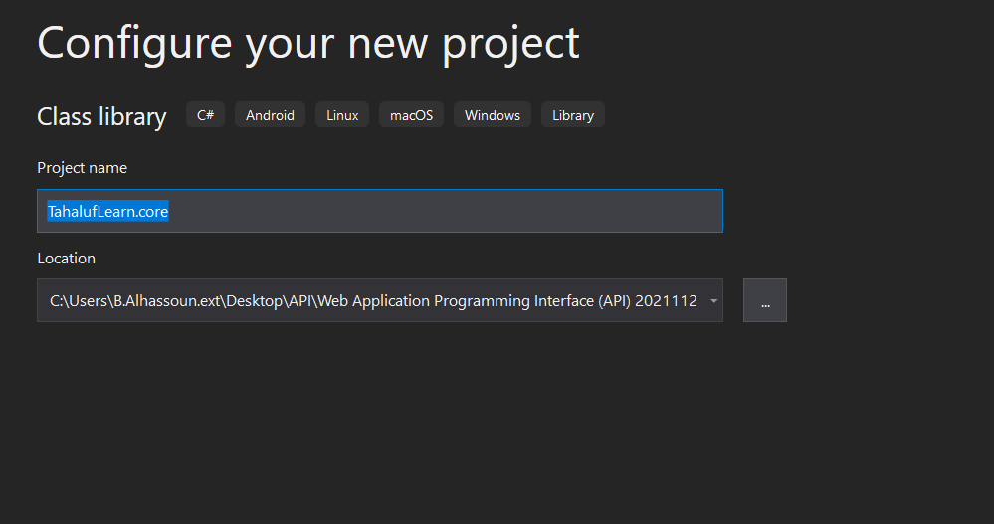
Tahaluf Copyright 2022- All Right Reserved
Harmony IT Solution
Enter Project Name (TahalufLearn.Core)

Slide 21
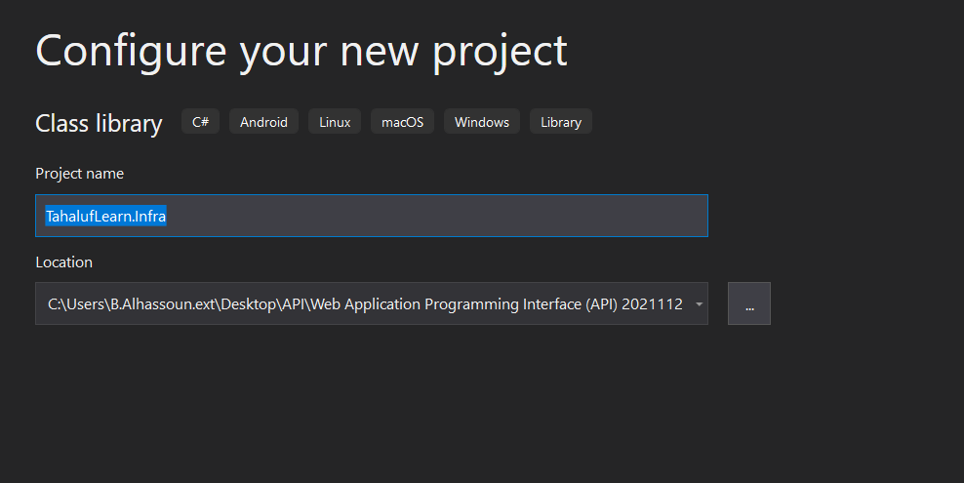
Tahaluf Copyright 2022- All Right Reserved
Harmony IT Solution
Enter Project Name (TahalufLearn.Infra)

Slide 22
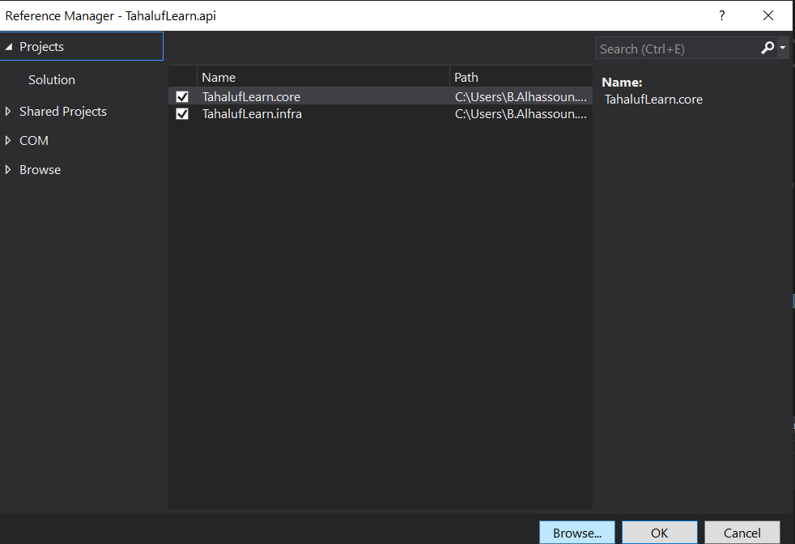
Tahaluf Copyright 2022- All Right Reserved
Harmony IT Solution
Create dependencies
Right click on dependencies in TahalufLearn.API => Add project reference => Choose TahalufLearn.Core & TahalufLearn.Infra => Ok

Slide 23
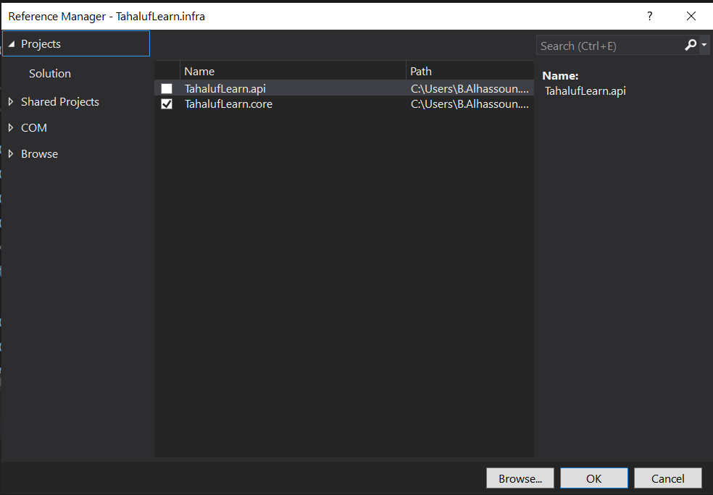
Tahaluf Copyright 2022- All Right Reserved
Harmony IT Solution
Create dependencies
Right click on dependencies in TahalufLearn.Infra => Add project reference => Choose TahalufLearn.Core => Ok

Slide 24
Tahaluf Copyright 2022- All Right Reserved
Harmony IT Solution
[1]. https://www.geeksforgeeks.org/introduction-postman-api-development/
[2].https://jakeydocs.readthedocs.io/en/latest/fundamentals/startup.html
[3]. https://dotnettutorials.net/lesson/asp-net-core-appsettings-json-file/

